Slide 1
ABSENTEEISM Predicting the reasons of wasting time during working hours.
PRESENTED BY :
Akash Anil Ubale
GitHub Link :- https://github.com/UbaleAkashAnil
linkedin:- https://www.linkedin.com/in/akash-ubale-915645180/

Slide 2



Akash Ubale
Aspiring Data Scientist
Education
Skills
Contact
Bachelor of Technology(2021),Kolhapur Institute Of Technology College of Engineering.
HSC Science(2017),Chate Jr College of Science.
SSC(2015),Hanmanthrao Chate School.
Pune,India
Python
Statistics
+91 8329544008
SQL
akashubale.2204@gmail.com
Excel
Pandas
www.linkedin.com/in/akash-ubale-915645180/
Work Experience
Hobbies
Languages
Internship Training
Zanvar Group of Industries Pvt.Ltd (Jan 2021 - May 2021)
English
Learn about Testing , Packaging , Transport of Organic Fertilizers and implemented all basic Agriculture knowledge gain with the a Practical and Industrial viewpoint
football
Music
Travelling
Hindi
Marathi

Slide 3

Workflow
Problem Statement
Attributes
EDA
Univariate Analysis
Multivariate Analysis
Data Engineering
Selecting Dependant & independent variable
Standardizing & splitting data
Model Building
Conclusion

Slide 4
Problem Statement
Its a company analysis where company wants to know the reasons, if employees are absent or not active during working hours and what are the reasons of it.

Slide 5
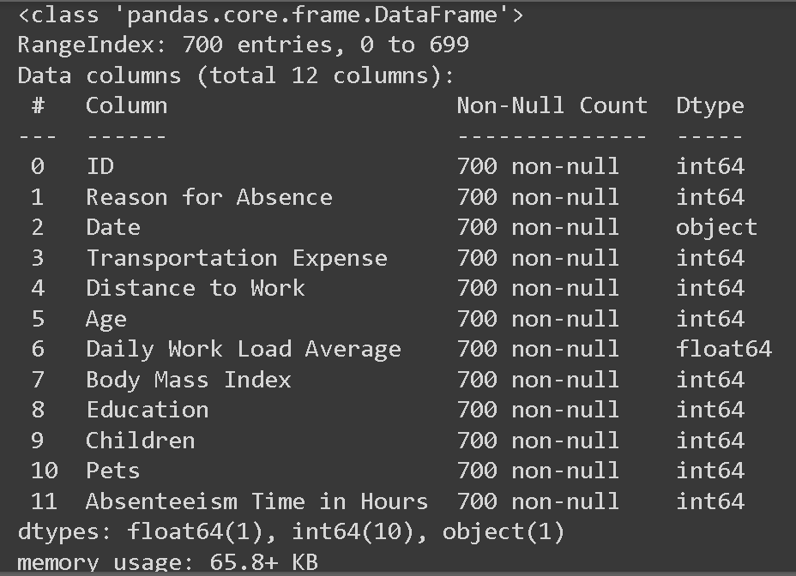
Attributes

Slide 6
Reasons of Absence
1. Disease of Blood | 15. ChildBirth
2. Certain Infectious Disease | 16. Condition originating from perinatal period
3. Neoplasm | 17. Congenital malformations
4. Metabolic disease | 18. Symptoms, Signs and Laboratory findings
5. Mental Disorder | 19. Injury, Poisoning
6. Disease of nervous System | 20. External Causes of morbidity
7. Disease of eye and adnexa | 21. Factors influencing health status
8. Disease of ear | 22. Patient follow up
9. Disease of circulatory system | 23. Medical consultations
10. Disease of skin | 24. Blood Donations
11. Disease of respiratory system | 25.Laboratory Examinations
12.Disease of connection tissue | 26. Unjustified absence
13.Disease of genitourinary system | 27. Physiotherapy
14. Disease of digestive system | 28.Dental consultation

Slide 7
EDA
Univariate Analysis

Slide 8
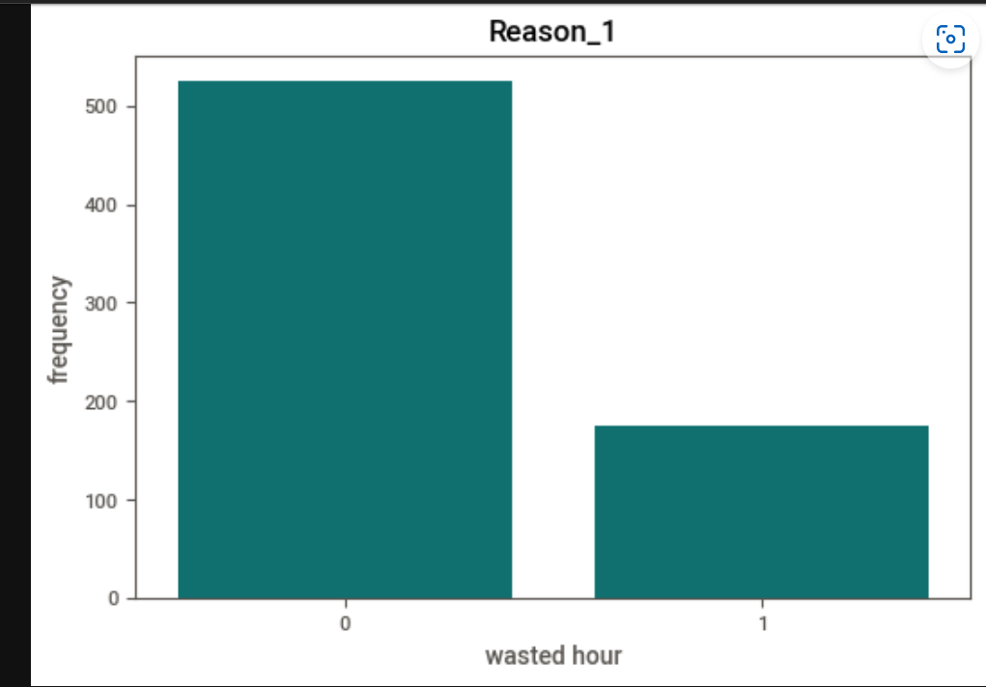
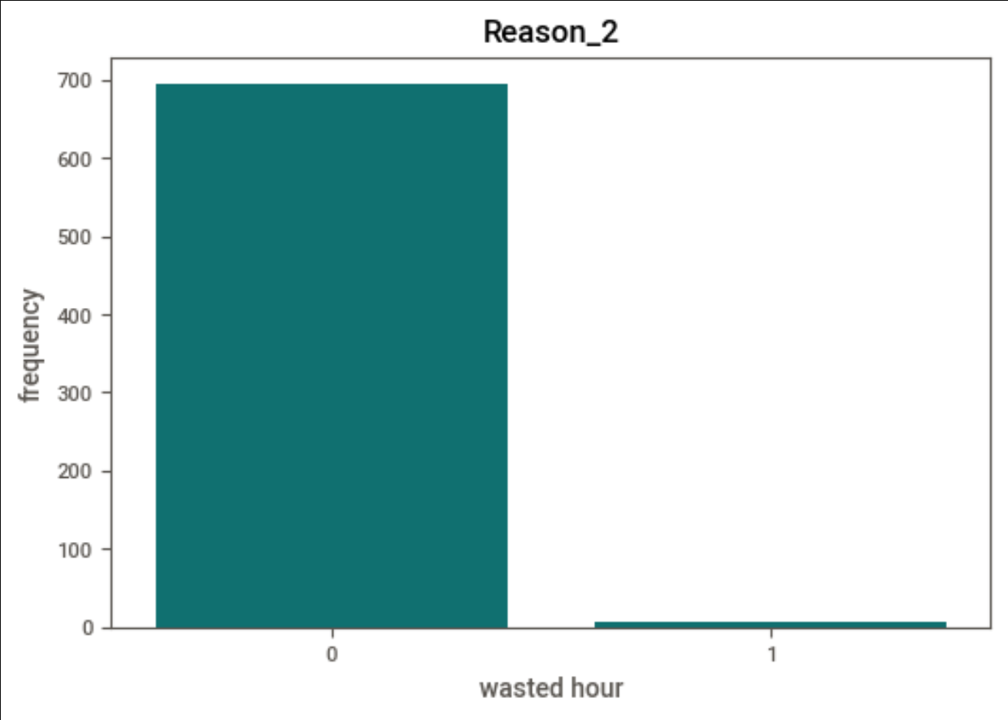
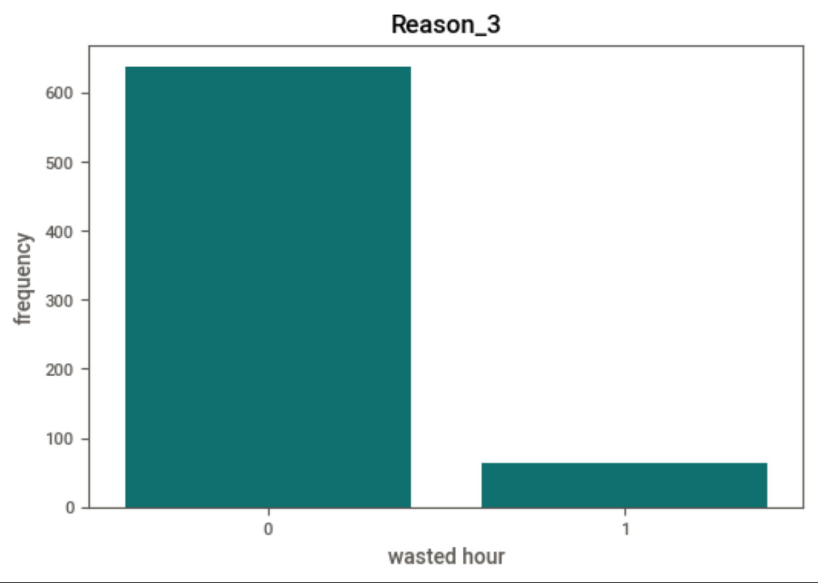
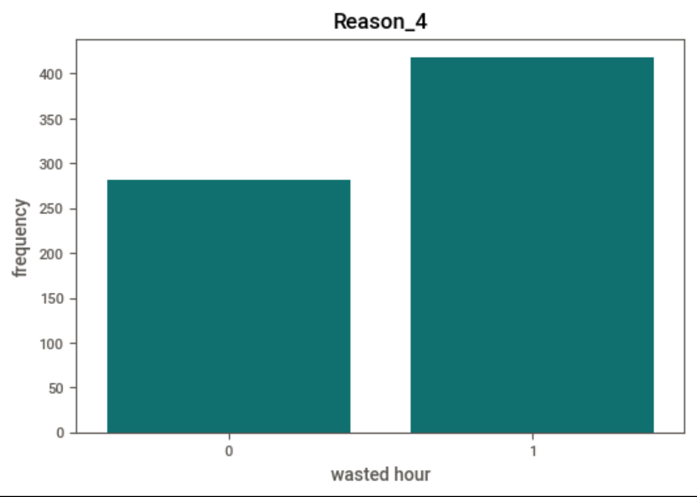

Slide 9
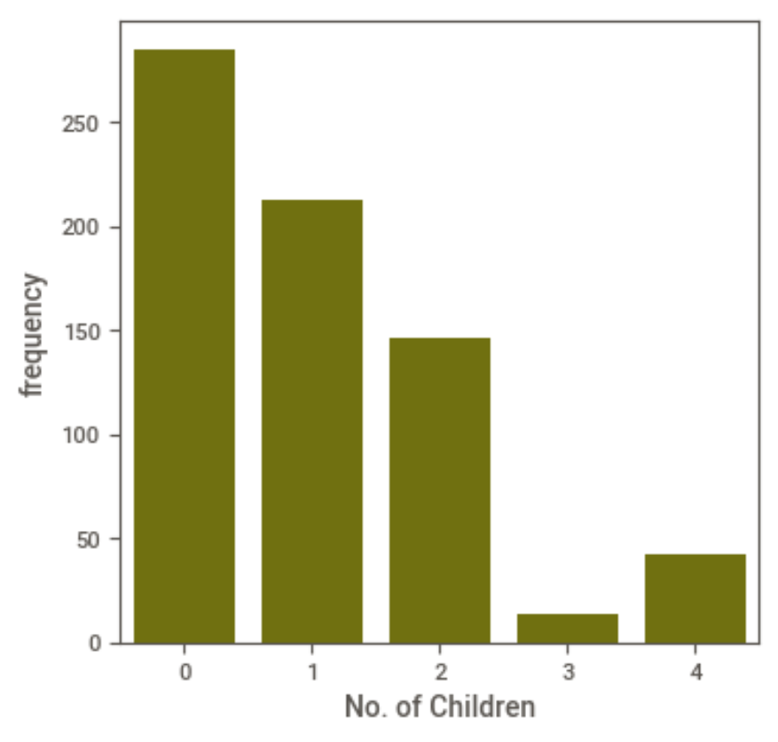
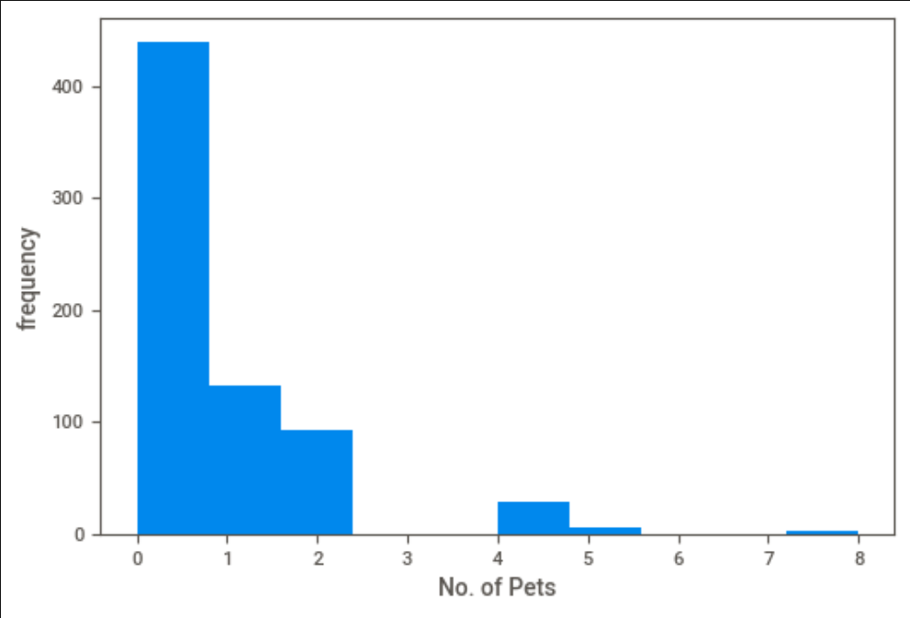

Slide 10
Multivariate Analysis

Slide 11
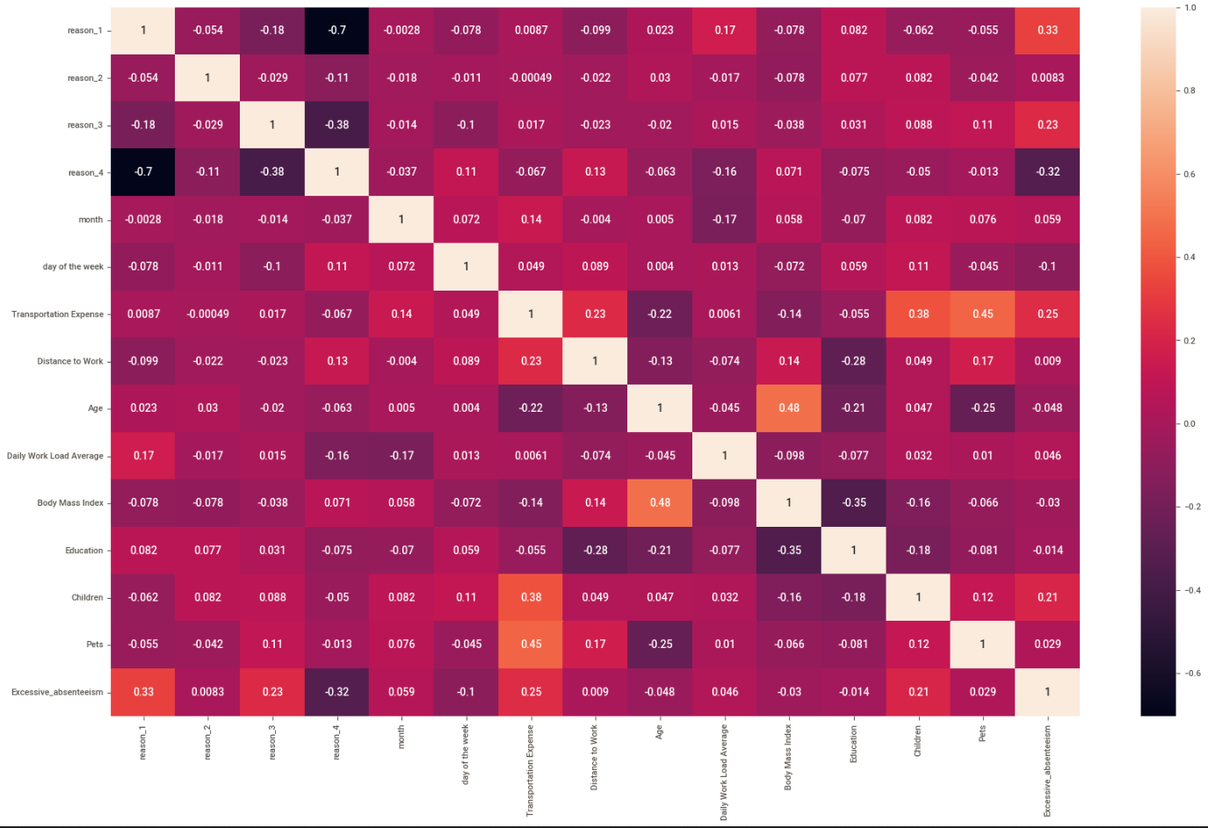

Slide 12
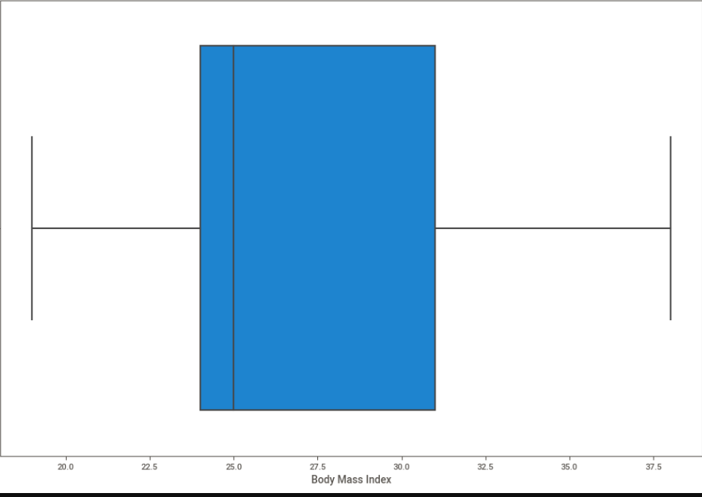
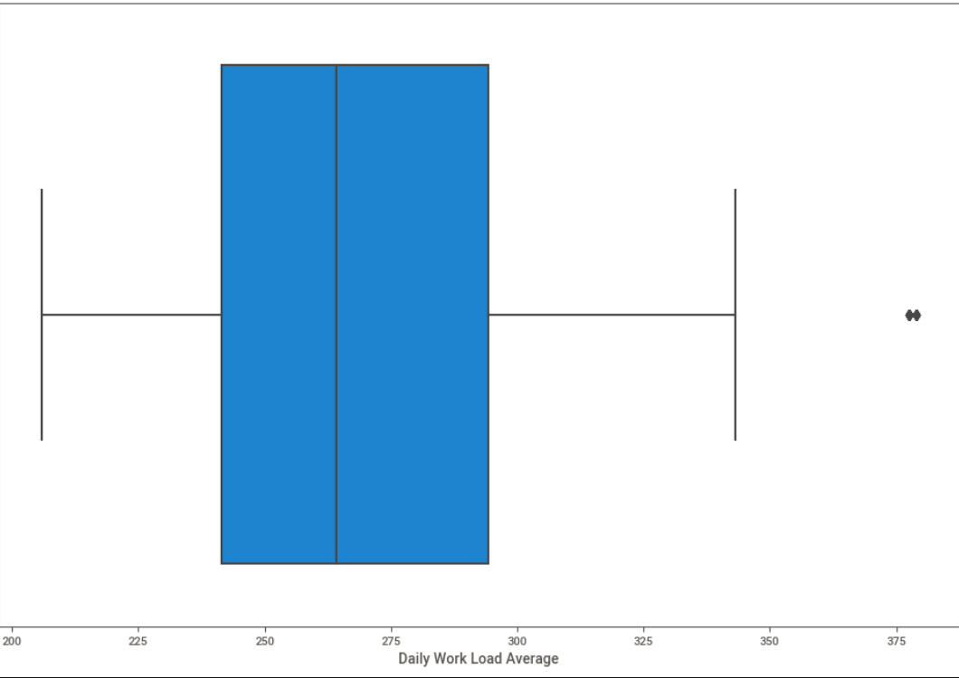
Outliers

Slide 13
Data Preprocessing
Categorical Value:
We don’t have categorical values in this data set.
One hot encoding:
We have to convert the column ‘Reasons of Absence’ and have to group it according to its similarity

Slide 14
Independent Variable and Dependent Variable
X = Reason_1, Reason_2, Reason_3, Reason_4, Month, Day of the week,
Transportation Expense, Body Mass Index, Daily Work Load Average,
Distance to work, Education, Pets, Children
Y = Excessive Absenteeism

Slide 15
Machine Learning Algorithm
Logistic Regression
Decision Tree Classifier
Random Forest Classifier
Support Vector Classifier
KNN Classifier
Gradient Boosting Classifier

Slide 16
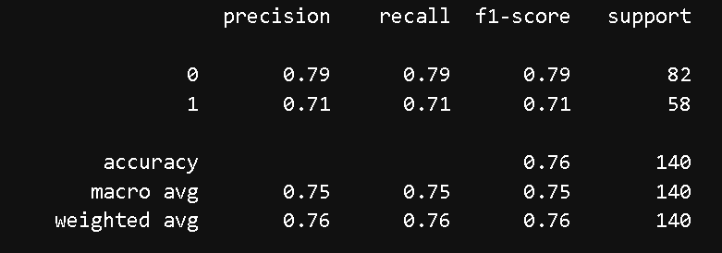
Logistic Regression
Library Used: From sklearn.linear_model import LogisticRegression
Training Accuracy : 0.77698
Testing Accuracy: 0.757142

Slide 17
Decision Tree Classifier
Library Used: from sklearn.tree import DecisionTreeClassifier
Training Accuracy: 0.983876
Testing Accuracy: 0.707142

Slide 18
Random Forest Classifier
Library Used: from sklearn.ensemble import RandomForestClassifier
Training Accuracy: 0.9821
Testing Accuracy: 0.7571

Slide 19
Support Vector Classifier
Library Used : from sklearn.svm import SVC
Training Accuracy: 0.7928
Testing Accuracy: 0.80

Slide 20
KNN Classifier
Library Used : from sklearn.neighbors import KNeighborsClassifier
Training Used: 0.7946
Testing Used: 0.7785

Slide 21
Gradient Boosting Classifier
Library Used: from sklearn.ensemble import GradientBoostingClassifier
Training Accuracy: 0.8571
Testing Accuracy: 0.80

Slide 22
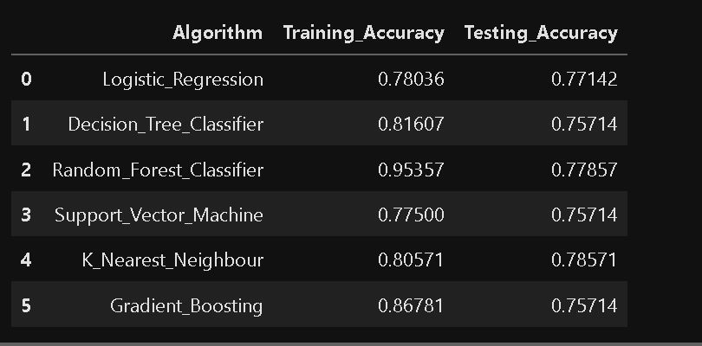
Result Of All Algorithm

Slide 23
Conclusion
KNN has given the best accuracy 0.7851. Through we conclude the reasons of employer wasting Time.

